Slide 1
PV is conserved is our strongest statement to explain weather But then where does PV come from?
ATM 405/561
Brian Mapes, Univ of Miami

Slide 2
Outline
Read this brief review of our journey from not-at-all-conserved momentum, to sorta-conserved relative vorticity, to more- conserved absolute vorticity, to most-conserved potential vorticity.
https://www.notion.so/miamimapes/Horizontal-vorticity-and-PV-as-explanations-for-cyclones-anticyclones-2e6d2c075dba44699dc822ca5748e2e8

Slide 3
Questions about it: write answers
1. Using the concepts from the reading, and earlier homework, explain how patches or elements of relative vorticity advect other patches of relative vorticity, under the assumption that relative vorticity is sorta almost conserved.
2. Using the concepts from the reading, and earlier homework, explain how planetary vorticity is converted to relative vorticity, so that their sum, the absolute vorticity, is almost conserved. Consider a loop of air moving in latitude, and explain how the different Coriolis force felt by its northern and southern edges acts as a torque on the fluid loop.
3. Using the concepts from the reading, and the reading, explain how static stability is converted to absolute vorticity, so that potential vorticity, their product, arguably the truest essence of vortices (cyclones and anticyclones) is really really almost conserved.
4. Based on the end of the reading, what you will look for in vertically resolved data about diabatic heating rate in the atmosphere to explain the ultimate source of PV?

Slide 4
Question 1 Answer
Consider two rotating areas of positive vorticity, arranged as depicted below. Assume relative vorticity is conserved - which is not a great assumption but is roughly true. Vortex A will advect vortex B towards the north. Meanwhile, vortex B will do the opposite and advect vortex A towards the south. This is because of the wind field that must be satisfied for these two points of vorticity (with all other areas having 0 relative vorticity) is proportional to 1/r, with r being the radius outward from the vorticity centers. As the centers move, they will eventually begin orbiting one another as depicted by the dashed outlines. The main takeaway is that vorticity centers can interaction with one another at great distances due to their induced wind fields.
A
B

Slide 5
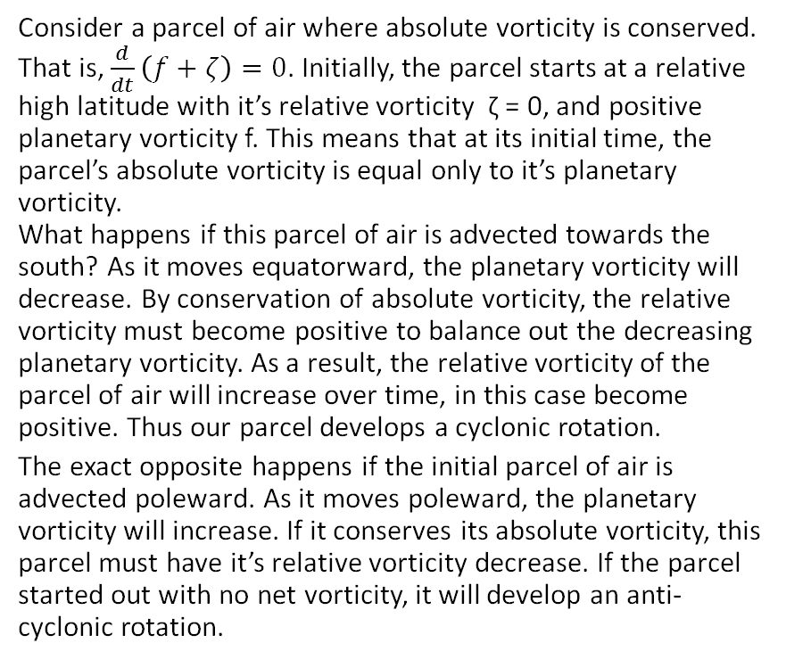
Question 2 Answer
ζ(t1) < 0
Consider a parcel of air where absolute vorticity is conserved. That is, $\frac{d}{dt}\left(f+ζ\right)=0$. Initially, the parcel starts at a relative high latitude with it’s relative vorticity ζ = 0, and positive planetary vorticity f. This means that at its initial time, the parcel’s absolute vorticity is equal only to it’s planetary vorticity. What happens if this parcel of air is advected towards the south? As it moves equatorward, the planetary vorticity will decrease. By conservation of absolute vorticity, the relative vorticity must become positive to balance out the decreasing planetary vorticity. As a result, the relative vorticity of the parcel of air will increase over time, in this case become positive. Thus our parcel develops a cyclonic rotation.
The exact opposite happens if the initial parcel of air is advected poleward. As it moves poleward, the planetary vorticity will increase. If it conserves its absolute vorticity, this parcel must have it’s relative vorticity decrease. If the parcel started out with no net vorticity, it will develop an anti-cyclonic rotation.
ζ(t=0) = 0
ζ(t1) > 0

Slide 6
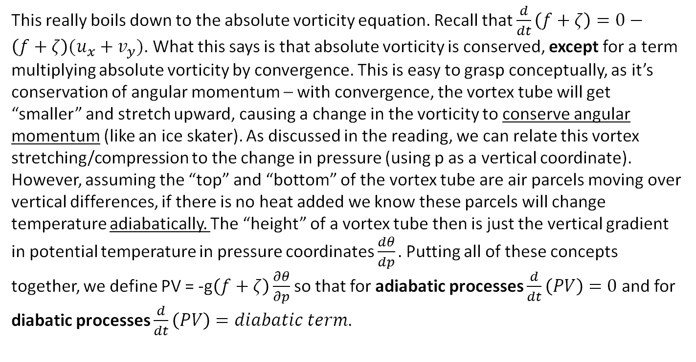
Question 3 Answer
This really boils down to the absolute vorticity equation. Recall that $\frac{d}{dt}\left(f+ζ\right)=0−\left(f+ζ\right)(u_{x}+v_{y})$. What this says is that absolute vorticity is conserved, except for a term multiplying absolute vorticity by convergence. This is easy to grasp conceptually, as it’s conservation of angular momentum – with convergence, the vortex tube will get “smaller” and stretch upward, causing a change in the vorticity to conserve angular momentum (like an ice skater). As discussed in the reading, we can relate this vortex stretching/compression to the change in pressure (using p as a vertical coordinate). However, assuming the “top” and “bottom” of the vortex tube are air parcels moving over vertical differences, if there is no heat added we know these parcels will change temperature adiabatically. The “height” of a vortex tube then is just the vertical gradient in potential temperature in pressure coordinates $\frac{dθ}{dp}.$Putting all of these concepts together, we define PV = -g$\left(f+ζ\right)\frac{∂θ}{∂p}$ so that for adiabatic processes $\frac{d}{dt}\left(PV\right)=0$ and for diabatic processes $\frac{d}{dt}\left(PV\right)=diabatic term$.

Slide 7
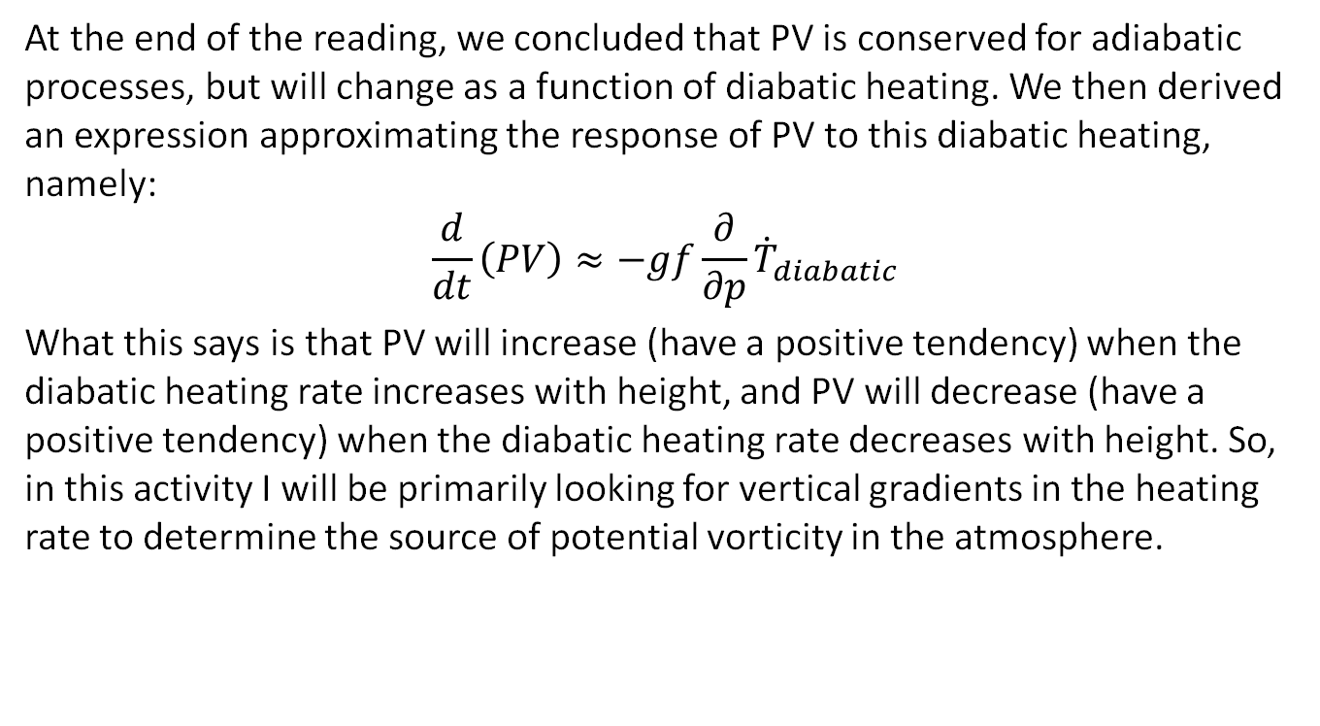
Question 4 Answer
At the end of the reading, we concluded that PV is conserved for adiabatic processes, but will change as a function of diabatic heating. We then derived an expression approximating the response of PV to this diabatic heating, namely:
$$\frac{d}{dt}\left(PV\right)≈−gf\frac{∂}{∂p}{\dot{T}}_{diabatic}$$
What this says is that PV will increase (have a positive tendency) when the diabatic heating rate increases with height, and PV will decrease (have a positive tendency) when the diabatic heating rate decreases with height. So, in this activity I will be primarily looking for vertical gradients in the heating rate to determine the source of potential vorticity in the atmosphere.

Slide 8
PV is conserved -- almost
APPROXIMATE term that generates PV on the Earth
Mostly, you are looking for WHERE THE DIABATIC OR PHYSICAL HEATING RATE INCREASES OR DECREASES WITH HEIGHT, weighted by (f+𝜁). In both hemispheres… so be careful with ”cyclonic”.

Slide 9
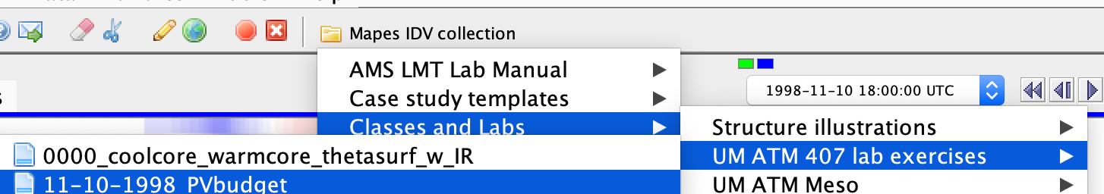
Assignment part 1: global view
Open the bundle 11-10-98 PV budget
Orient yourself to its displays, in both windows
a pole-to-pole transect of the zonal mean heating rates (averaged around the whole Earth)
A map view with many displays (including movable cross sections).

Slide 10
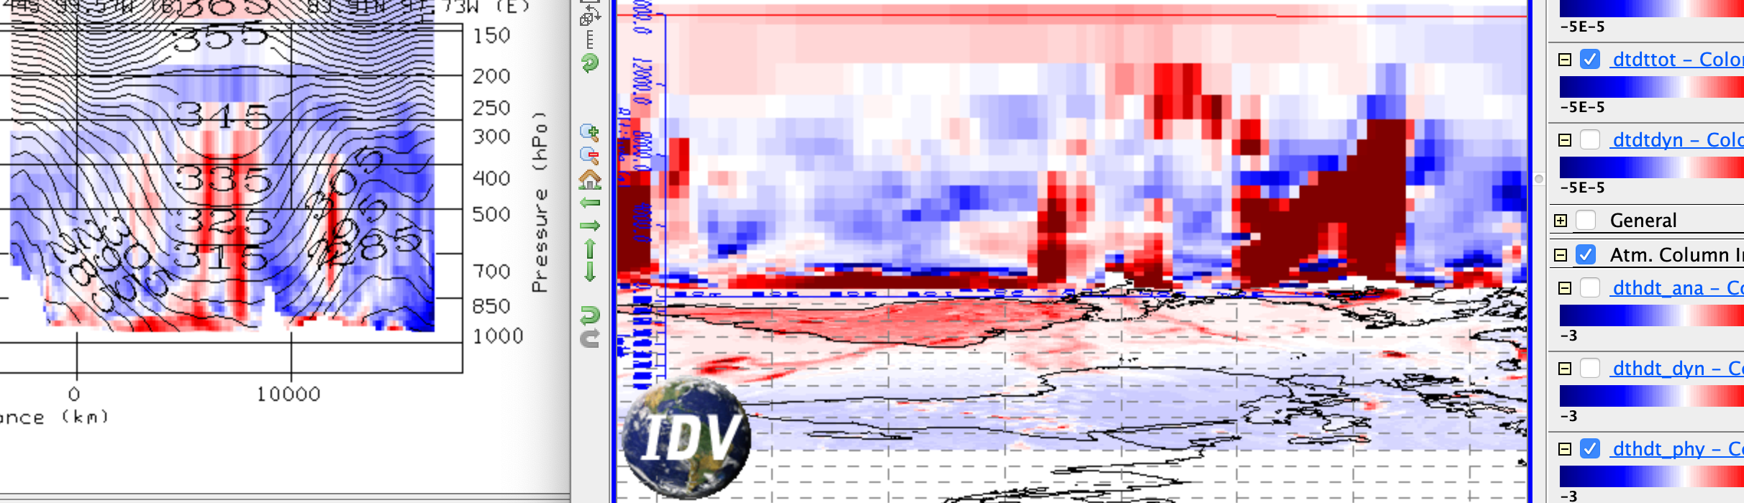
transect of zonal mean diab. heating, cross section of total diab. heating, map of column integral diab. heating

Slide 11
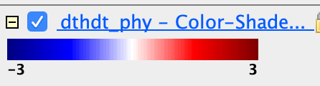
Assignment part 1: global view
What time of year is it? How can you see that in the column-integrated heating rate map dthdt_phy, or other radiative heating rates?

Slide 12
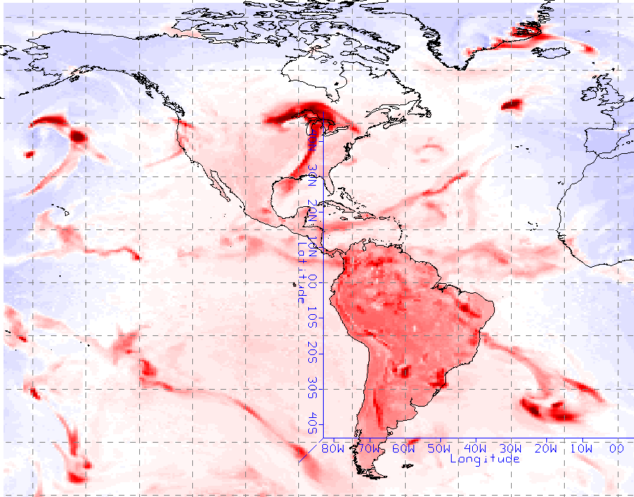
Answer to 1
The date on the IDV bundle indicates that this slide is taken on November 10th. Looking at column integrated heating rate, it is clear that the land surfaces in the Southern Hemisphere during the daytime (left half of the screen) generally have higher values than corresponding regions in the Northern Hemisphere. This would suggest the general heating is greater south of the equator than north of it, reflective of the shift in incoming radiation during the Northern Hemisphere late fall/winter.

Slide 13
Assignment part 1: global view
Now turn to the Transect View window, showing average cross sections all around the Earth. Create a slide showing the transect of total diabatic heating. Label it: where is the south pole, the north pole? Hint: Antarctica is mountainous.
The units of all heating rates are are K/s. What is the color range in K/day?

Slide 14
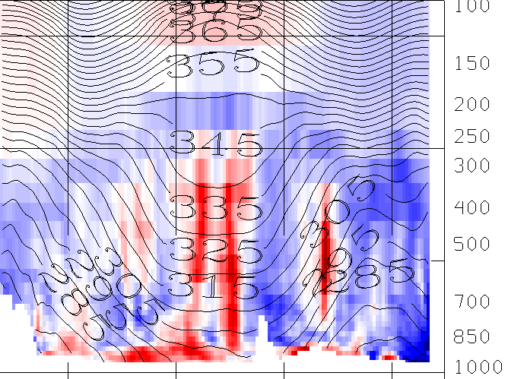
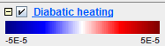
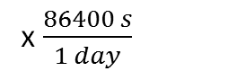
Answer to Transect View Window
Tropopause higher in tropics than mid-latitudes
South Pole
North Pole
x $\frac{86400 s}{1 day}$
4.32
4.32
K/s
K/day

Slide 15
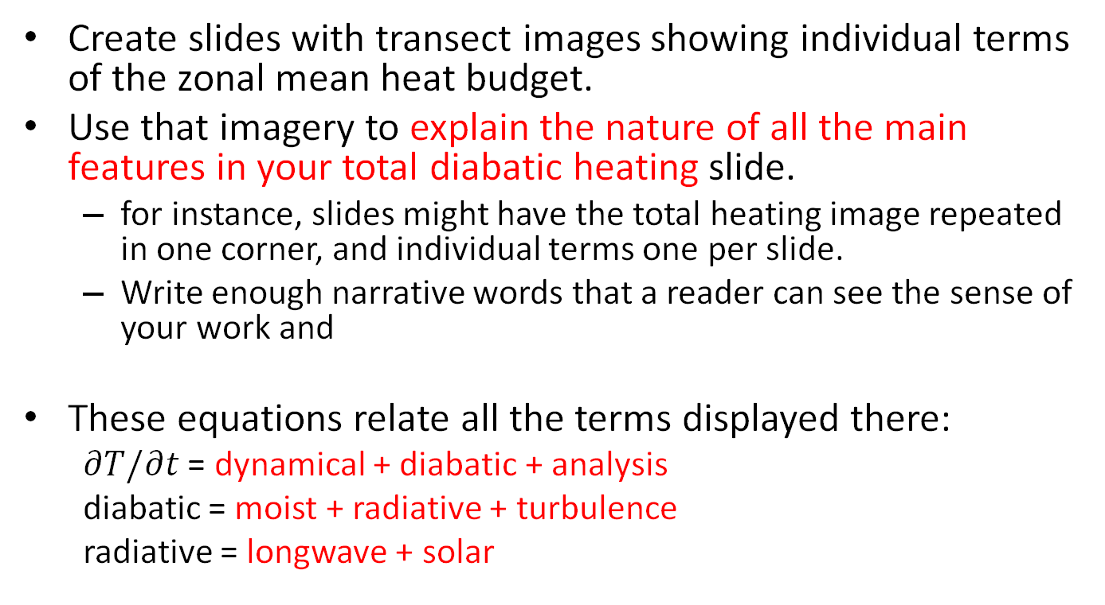
Assignment part 1: global view
Create slides with transect images showing individual terms of the zonal mean heat budget.
Use that imagery to explain the nature of all the main features in your total diabatic heating slide.
for instance, slides might have the total heating image repeated in one corner, and individual terms one per slide.
Write enough narrative words that a reader can see the sense of your work and
These equations relate all the terms displayed there:
$∂T/∂t$ = dynamical + diabatic + analysis
diabatic = moist + radiative + turbulence
radiative = longwave + solar

Slide 16
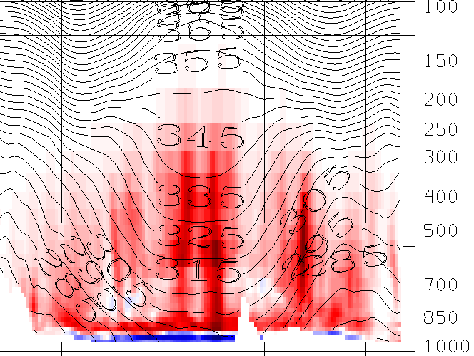
Moist Heating
In the diagram to the right, notice the large amounts of moist (latent) heating in the atmosphere, especially between 850hPa and 250hPa. While most of the atmosphere is seeing positive values of latent heating, the surface shows negative values. This is simply a product of evaporation “removing” heat from the surrounding environment (occurring primarily at the ocean surface) and condensation higher in the atmosphere “adding” heat. Notice that the bands of high latent heating are associated with similar bands in the total diabatic heating map, and are likely latitudinal bands with large amounts of convective activity.

Slide 17
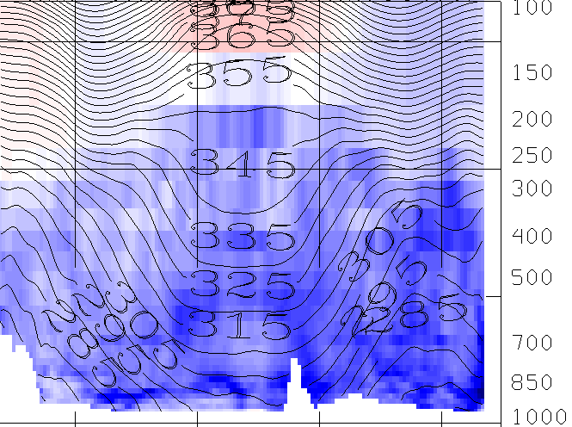
Total Radiational Heating
In this diagram, the entirety of the tropospheric air is shown to experience radiational cooling. However, radiational warming is evident in the stratosphere. We will break next break this down into longwave and shortwave (solar) contributions. Ultimately, we will find that longwave cooling dominates in the troposphere, and responsible for the general cooling of the troposphere in the total radiation budget (ignoring the bright bands of warming associated with latent heat). Also, notice the enhanced region of radiational cooling in the upper troposphere/stratosphere in radiation, clearly leaving and imprint on total diabatic heating.

Slide 18
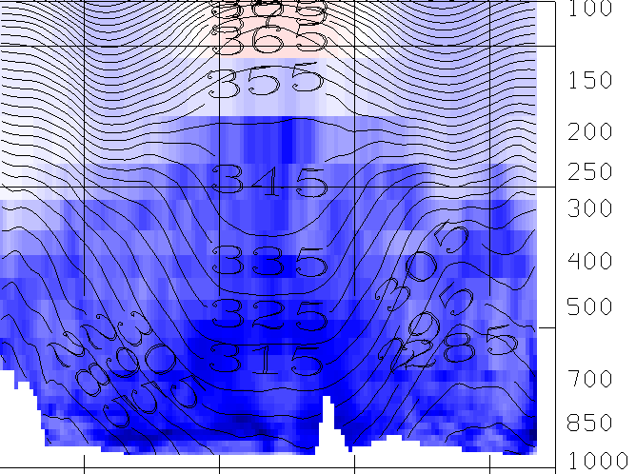
Longwave Radiational Heating
As mentioned before, radiational heating is dominated by longwave outgoing radiation in the troposphere. Meanwhile, the stratosphere seems to have a net absorption of LW radiation, especially right over the tropics.

Slide 19
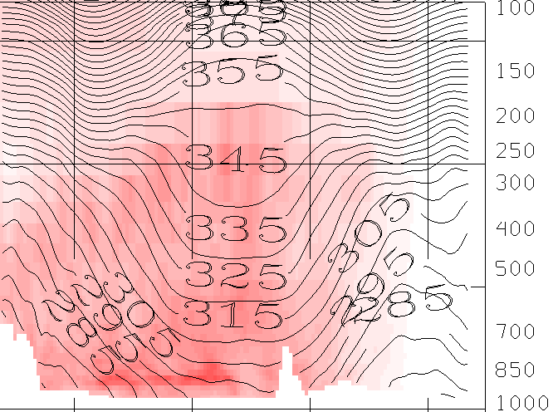
Solar Radiational Heating
This slide is indicative of the time of year, with the Southern Hemisphere (right of image center) receiving overall more solar radiation than the Northern Hemisphere. Thus, we know this is likely late fall or winter for the Northern Hemisphere. While there’s a net heating in the atmosphere from solar radiation, it is generally lower in magnitude than longwave radiation, so the direct impact of this term is not as evident in the total diabatic heating term.

Slide 20
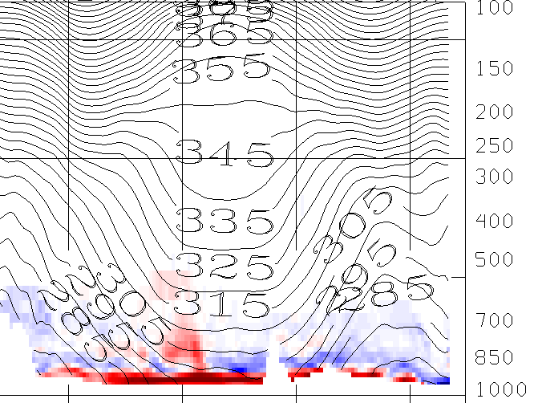
Turbulent Heating
From this diagram we can see that turbulent heating is confined to the planetary boundary layer (PBL) in the lowest few hundred hPa of the atmosphere. This is induced by winds, and generally has the effect of heating in the lowest part of the atmosphere. We can see that turbulence is the dominant heating term in the lowest hundred hPa of the atmosphere, as this bright red heating band also appears in the the total heating diagram.

Slide 21
Assignment part 1: global view
Radiation and clouds:
Toggle the cloud fraction display with the radiative heating rate displays. Can you see any features that clearly indicate how clouds affect radiation?
clouds scatter solar photons, which are absorbed by vapor, especially at low levels.
clouds cool by emitting longwave from their tops
clouds absorb upwelling longwave from the surface at their bases (hard to see in the zonal mean, clearer in individual cross sections in Part 2)

Slide 22
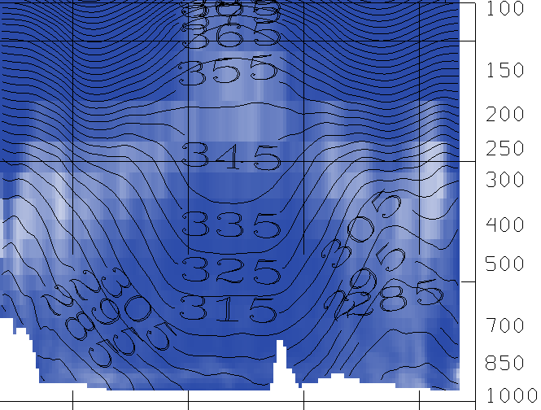
Radiation and Clouds
Clouds scatter solar photons and enhance shortwave absorption of air at low levels
Clouds associated with more longwave cooling, especially at/right above their level

Slide 23
Assignment part 1: global view
From your total diabatic heating, indicate areas where PV tendency is positive and negative. Also label these areas as cyclonic or anticyclonic tendencies.
Does the zonal mean PV transect resemble areas where your PV tendency is strong? It’s not so simple: PV has a long lifetime in the stratosphere, so a large source is not required to explain a large value.
How does this zonal-mean PV show the imprint of both its vorticity factor and its static stability factor? Label an image to explain your answer.

Slide 24
Total Diabatic Heating and PV
Because $\frac{d}{dt}\left(PV\right)≈−gf\frac{∂}{∂p}{\dot{T}}_{diabatic}$, we expect PV to increase in regions with increasing diabatic heating with height, and to decrease in regions with decreasing diabatic heating with height.
d/dt(PV) > 0
d/dt(PV) > 0
d/dt(PV) > 0
d/dt(PV) < 0
d/dt(PV) > 0
d/dt(PV) > 0
d/dt(PV) < 0
d/dt(PV) < 0
South Pole
North Pole

Slide 25

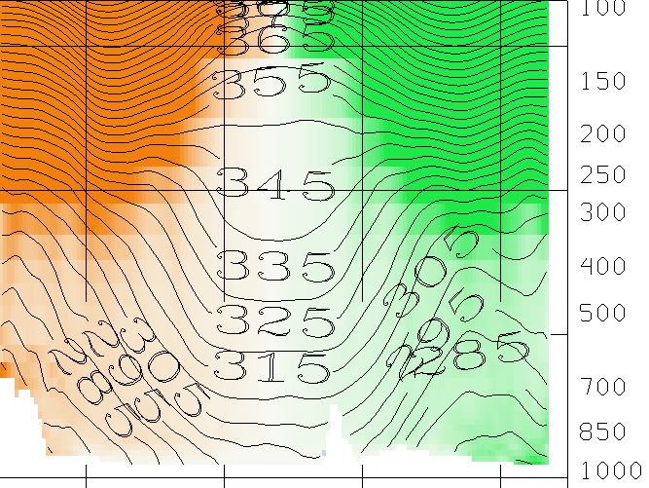
Actual zonal-PV slice
Does not appear similar to my tendency (change) interpreted by the diabatic heating slice. Likely due to the large values of PV already present in these regions – when you average, wash out variations seen in storms/localized areas and also seen the sign of planetary vorticity dominate.
Stratosphere – theta lines closer together (more stratified) so PV will be amplified above the tropopause
S.H.– dominated by planetary vorticity (f<0) so largely negative
N.H.– dominated by planetary vorticity (f>0) so largely positive

Slide 26
Assignment part 2: Local sections
Now explore the cross section displays in the Map View window.
You can drag the cross section around to storms or other features. Drag them to north-south positions that slice through tropical and higher latitude weather features that interest you (perhaps guided by other displays).

Slide 27
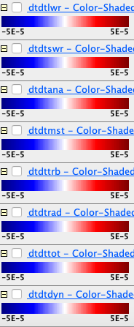
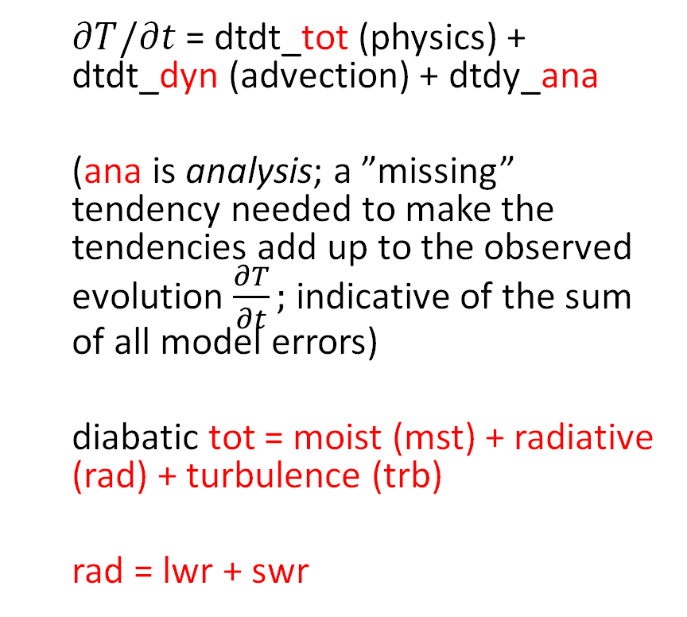
Legend explanation for cross sections
longwave
shortwave
$∂T/∂t$ = dtdt_tot (physics) + dtdt_dyn (advection) + dtdy_ana
(ana is analysis; a ”missing” tendency needed to make the tendencies add up to the observed evolution $\frac{∂T}{∂t};$ indicative of the sum of all model errors)
diabatic tot = moist (mst) + radiative (rad) + turbulence (trb)
rad = lwr + swr
analysis
(0 for perfect model)
moist mst
(convection & cloud cond. )
turbulence
(PBL)
SW+LW radiation
total physics (”diabatic”)
dynamic (advective)

Slide 28
Assignment part 2: Local view
Make comparison slides juxtaposing the zonal-mean transects and your local cross-sections, like in slide 6 above.
Toggle the various terms making up the total diabatic heating, in order to explain
Which is more variable (more spatially concentrated): radiative or moist heating? Illustrate your answer with images.

Slide 29
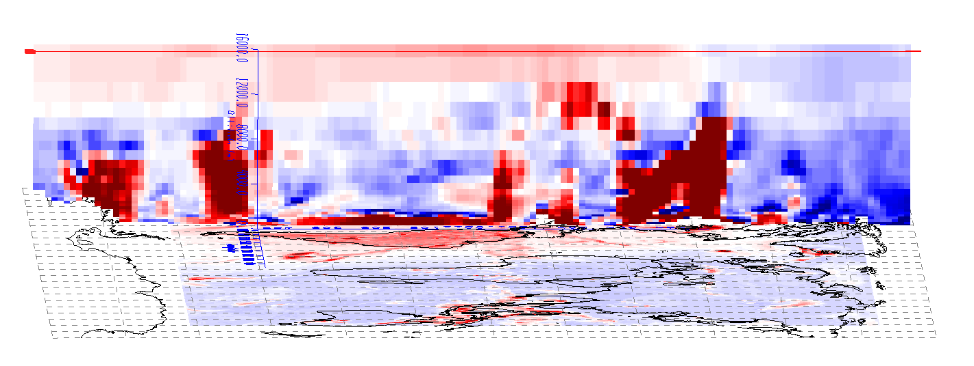
Global Mean vs. Local: Total Heating
There appears to be many obvious differences in the global, zonally averaged total diabatic heating from what is seen on a local longitudinal slice. This is especially obvious in some regions where extremely high, concentrated values of positive and negative diabatic heating are observed.
Local slice (at 89W)
Zonally Averaged

Slide 30
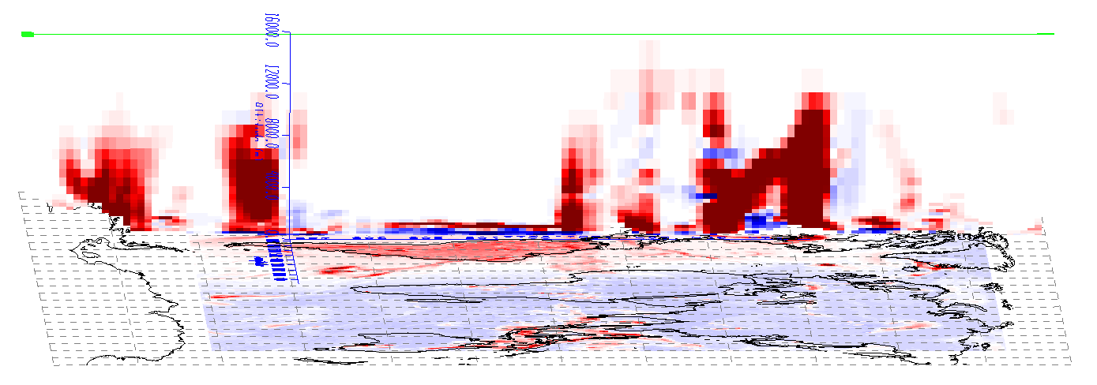
Global Mean vs. Local: Moist Heating
Moist diabatic heating exhibits a large scale of variability compared to zonally averaged terms. Notice that in the zonally averaged slice, large values of latent heating are evident in most of the troposphere, with a few areas of enhanced positive heating. For the local slice, this heating is much more concentrated, though the low-level cooling appears similar.
Local slice (at 89W)
Zonally Averaged

Slide 31
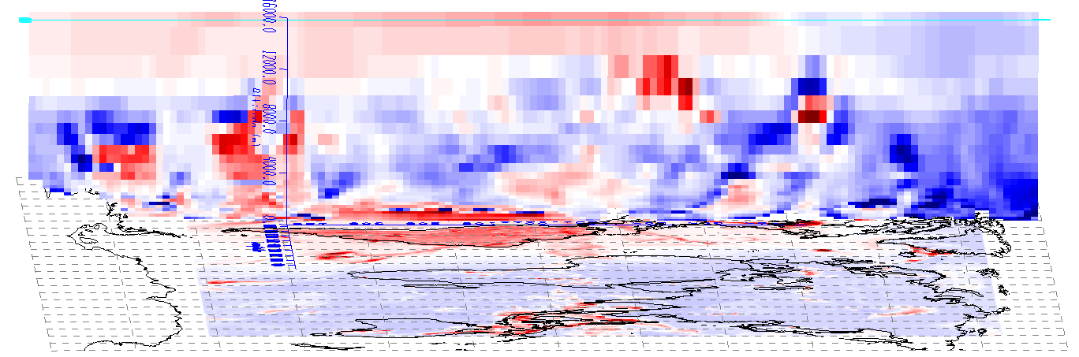
Global Mean vs. Local: Total Radiational Heating
Variability also exists in the total radiational heating term, likely the result of local cloud impacts. However, the general behavior in the troposphere still exhibits cooling, with small pockets of heating we will later attribute to clouds. Notice the generally cloud-free stratosphere remains much the same in the local and avg. slices.
Local slice (at 89W)
Zonally Averaged

Slide 32
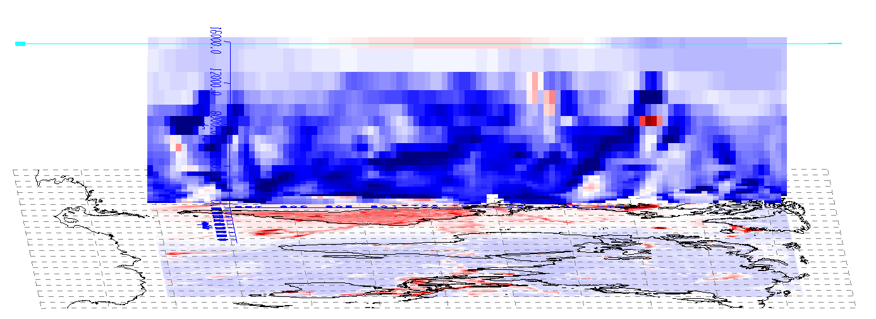
Global Mean vs. Local: Longwave Radiational Heating
Breaking down the radiative heating term, I noticed the longwave radiation again appears to be mostly negative throughout the troposphere in both the local and zonally averaged slices. However, notice the variability in the concentration of cooling, and even the presence of longwave heating in small tropospheric pockets.
Local slice (at 89W)
Zonally Averaged

Slide 33
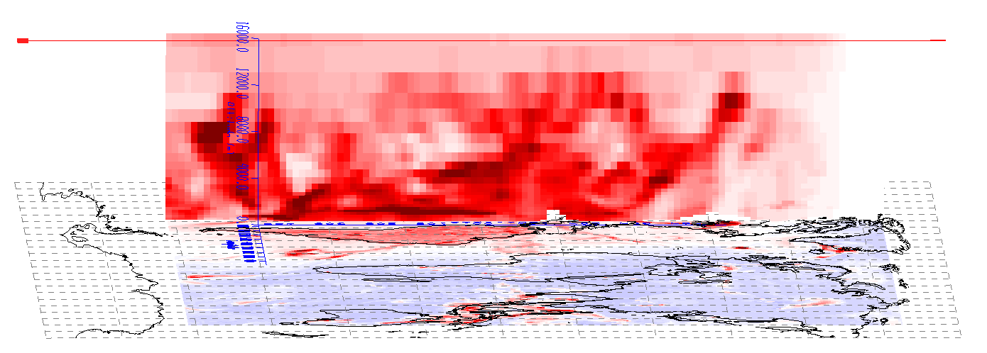
Global Mean vs. Local: Solar Radiational Heating
Less noticeable variability exists in shortwave radiation for the local slice versus the zonally averaged slice. There is a general heating term throughout the troposphere. However, notice small pockets of concentrated values, likely associated with clouds.
Local slice (at 89W)
Zonally Averaged

Slide 34
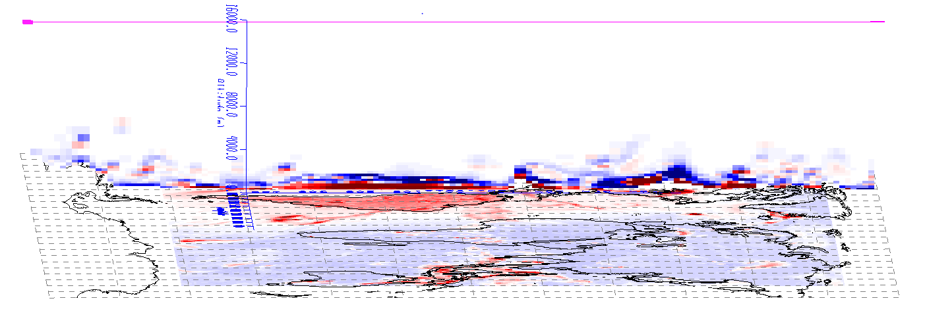
Global Mean vs. Local: Turbulent Heating
I found the least amount of variability between local and zonally averaged slices in pattern of turbulent heating. Notice both have high concentrations of heating right next to surface, and smaller magnitude cooling right above.
Local slice (at 89W)
Zonally Averaged

Slide 35
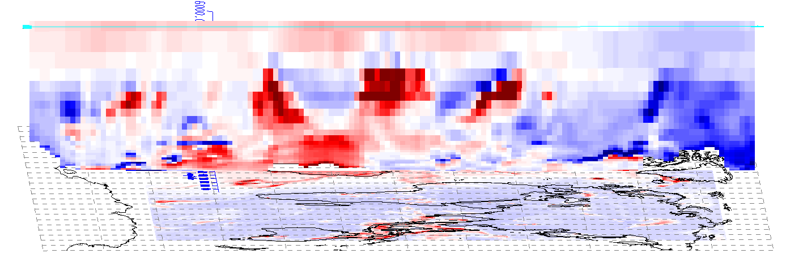
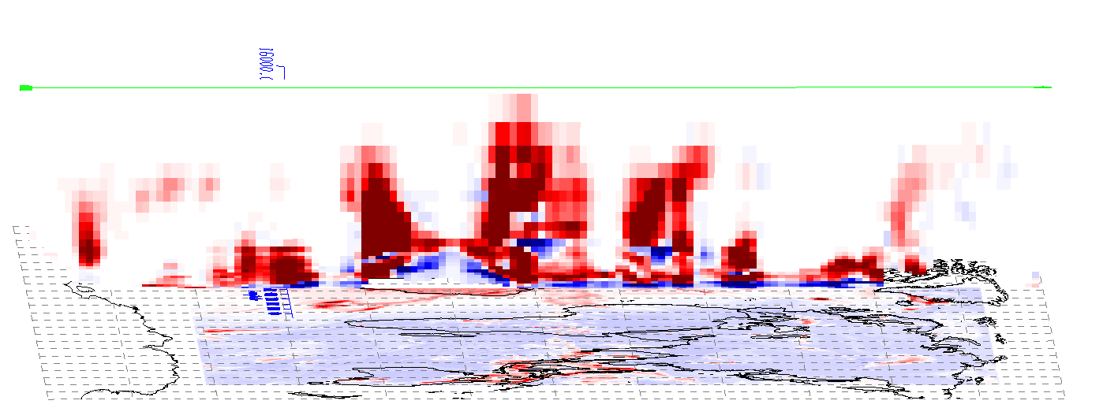
What’s more variable – moisture or radiation?
As noted in the previous slides, both radiation and moisture heating experienced variations in the pattern of local behavior compared to a zonally averaged mean. However, the moisture term appeared much more concentrated and variable in the local slice than the radiation term. This can also be illustrated by comparing slices of each of these terms at different longitudes. While both show local differences, the concentration of latent heat release is intrinsically connected to convective activity which is incredibly variable in space and time. While longwave radiation is partially connected to cloud distribution, the general pattern of LW and SW radiation throughout the troposphere is relative similar neglecting the local cloud impacts.
89W
50W

Slide 36
Assignment part 2: Local view
Revisit cloud-radiative interactions
LW radiation can be understood as water vapor cooling, cloud top cooling, and cloud base warming. Toggle the layers to find a good example, then juxtapose cloud fraction and radiative heating cross-section images to show an example of a place where cloud effects are dominant

Slide 37
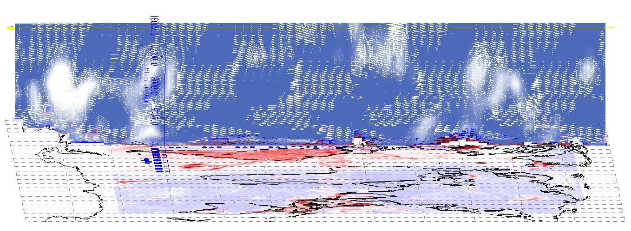
Cloud Impacts: Answer
Here I have provided an example of cloud influence on LW radiation. Take not of the circled area in both the LW radiation plot and cloud fraction plot. At the bottom of the cloud, notice the large amount of radiative heating associated with the cloud base absorbing LW radiation emitted from below. At the top of the cloud there is enhanced LW cooling associated with the emittance of LW radiation from the cloud, resulting in cloud top cooling.
LW diabatic heating
Cloud fraction

Slide 38
Assignment part 2: Local view
Consider the PV source term motivating this exploration.
Where does the vertical gradient of heating imply large PV sources? Use arrows to annotate a couple positive and negative source regions.
Can you find a weather situation where this source term is a positive feedback on PV?

Slide 39
Total Heating and PV Generation
Below I have annotated some regions in my PV slice with source regions for both positive and negative PV. This is all due to the relationship of PV to the vertical gradient of diabatic heating – with a positive gradient of diabatic heating (z), positive PV should be generated (positive tendency) and with a negative vertical gradient (z) of diabetic heating, should be negative tendency.
Negative tendency
Positive tendency near surface
and near tropopause

Slide 40
Latent Heating and PV Generation
Notice that the primary contributor to diabatic heating is the latent heating term, with most of the high concentration areas shown on the last slide directly corresponding to the latent heating diagram shown below.
Conceptually, this means that latent heating in the atmosphere – the result of condensation – will likely result in the generation or increase in positive PV at the bottom of the cloud/convection and a negative tendency above the cloud.

Slide 41
Positive Feedback
Where would one expect to find such a feedback? Think of convection and condensation associated with a large-scale region of positive PV concentrated near the surface. This often occurs with tropical storms or mesoscale convective vortices (MCVs). If we associate the strength of the system with the convection and latent heat release, then this will constitute a positive feedback. As the PV system strengthens, so will the latent heat release, which will generate more PV and continue the cycle. This is illustrated below.

Slide 42
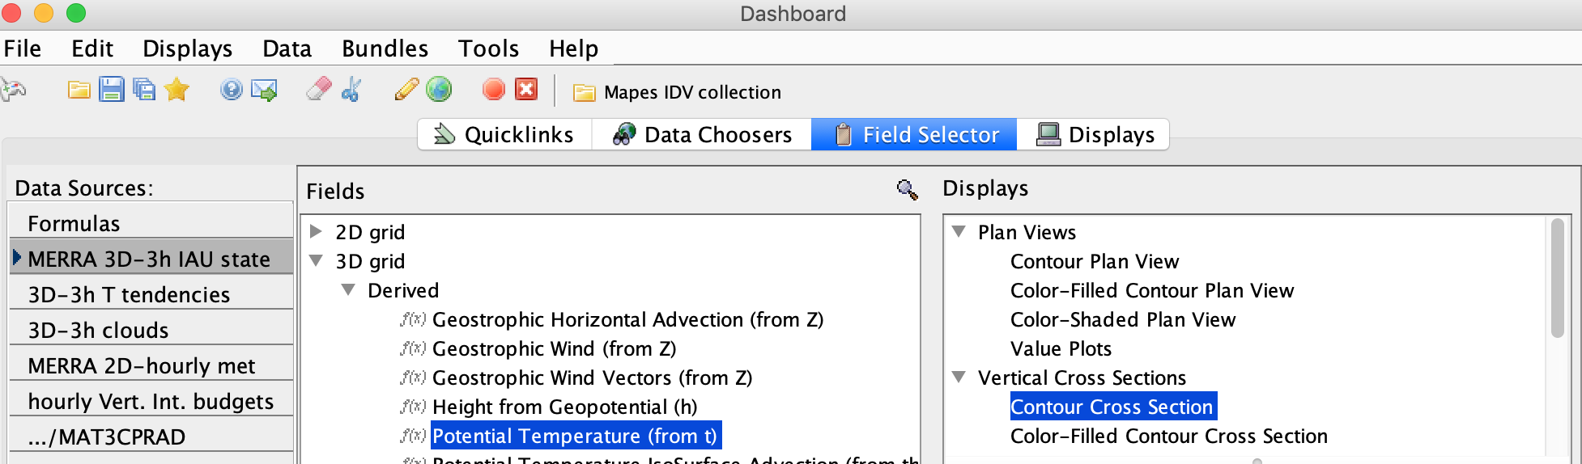
Create a new cross section of potential temperature contours

Slide 43
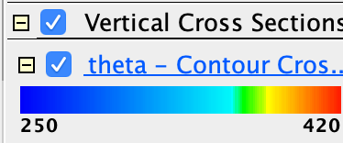

Create a new cross section of potential temperature contours
Now click its Legend entry to pop up its Display Controls.
Change the contour interval to 5K. Change the Color to Black. Change their label size to 20.

Slide 44
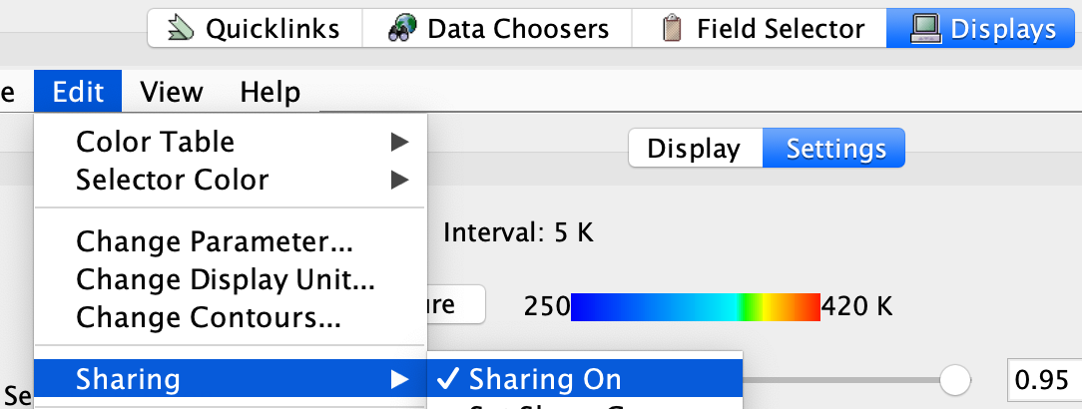
Create a new cross section of potential temperature contours
Again click the Legend entry to pop up the Display Controls.
Under the Edit menu, turn on Sharing
Move the main north-south cross section slightly. This will make your new theta contour section snap into place with it.

Slide 45
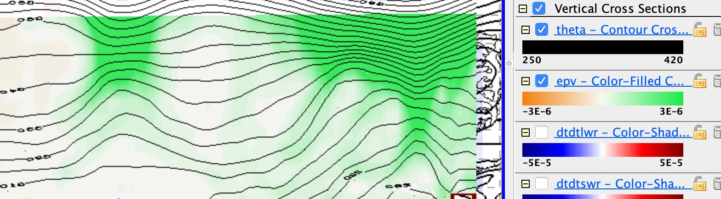
Create a new cross section of potential temperature contours
You should see our familiar relation between theta surfaces and (most clearly) upper-level cool core cyclones:

Slide 46
Warm and cool cores & condensation heating
Use the cross section with theta contours and the moist-processes heating rate (dtdtmst) to find an example
with the condensation heating in a warm core storm, like the one halfway to Ireland
how does the PV source term from latent heating feed back on such a warm core storm?

Slide 47
Warm and cool cores & condensation heating
Use the cross section with theta contours and the moist-processes heating rate (dtdtmst) to find an example
where a cool core cyclone (lifted isentropes, cyclonic PV aloft; a tentacle of the polar vortex) may be gently lifting air to its condensation level, releasing some latent heating
how does the PV source term from latent heating feed back on such a cool core storm?

Slide 48
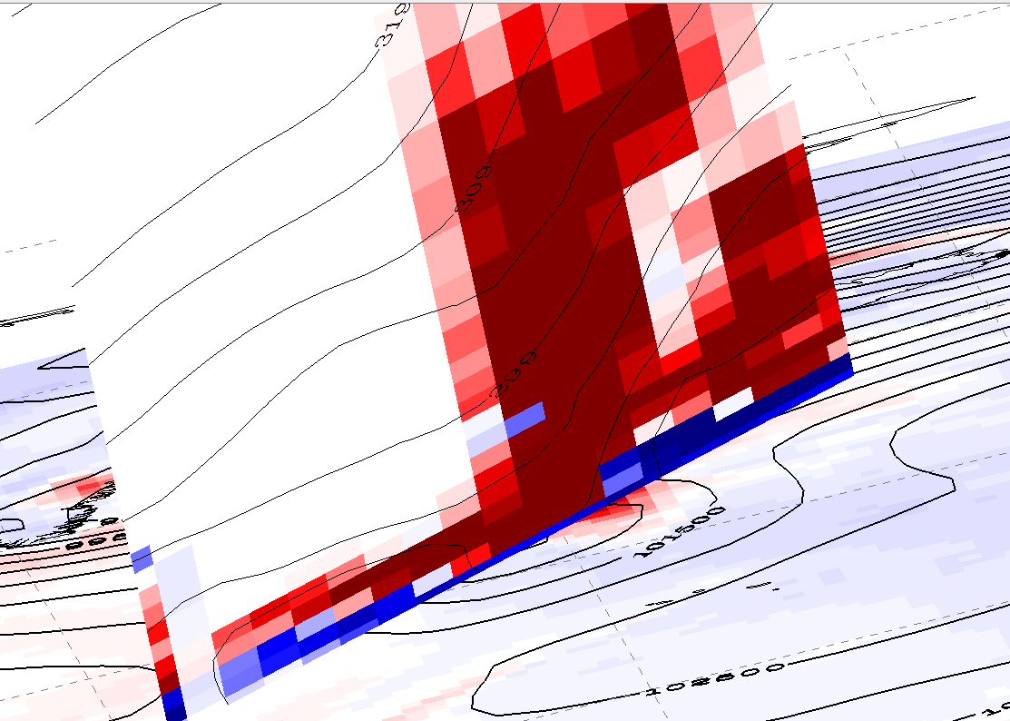
Warm Core Example
In this cross-section through a warm-core system, focus on the selected region. Co-located with the PV core (which is maximized right near the surface, as implied by the potential temperature contours) is a extremely large and positive (z) vertical gradient of latent heat. This will result in a positive tendency in PV, which could feedback and cause more lifting and more latent heating. This is a positive feedback, and one commonly associated with warm-core features such as hurricanes.

Slide 49
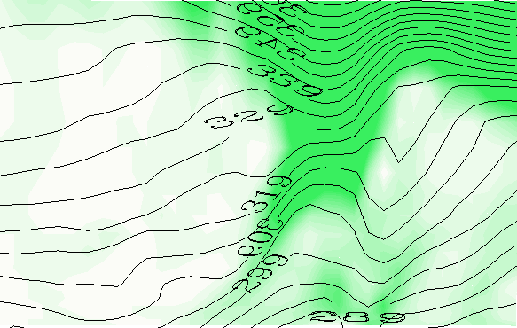
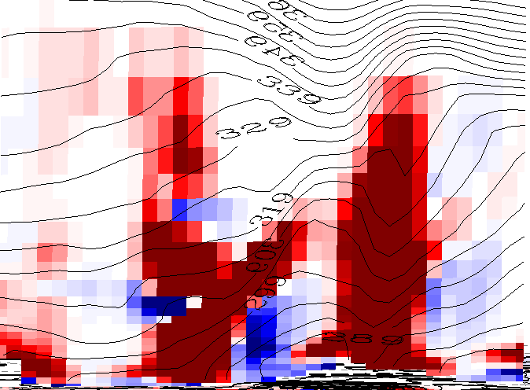
Cold Core Example
In this cross-section through a cold-core system, focus on the selected region. Consider that the area of PV has gently lifted this parcel of air to condensation, right below the upper-level maximum in PV. Above this maximum and co-located with the PV core aloft, there will be a negative vertical gradient (z) which will result in a negative PV anomaly. As a result, the latent heat release will have a negative feedback on the area of positive PV.

Slide 51
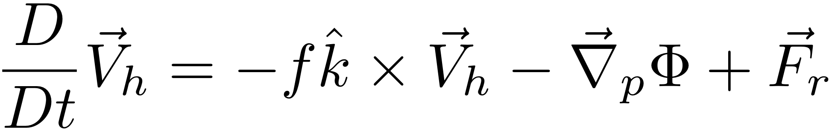
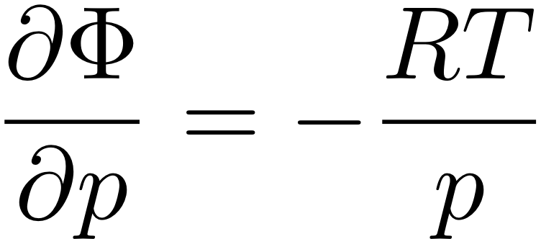
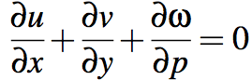
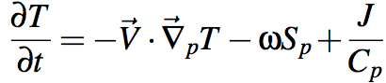
“The Primitive Equations”
(meaning elemental, fundamental)
F=MA in the HORIZONTAL
HYDROSTATIC (w/ ideal gas law to eliminate ρ)
MASS CONSERVATION
FIRST LAW OF THERMO
Notes:
\frac{D}{Dt} \vec V_h = -f \hat k \times \vec V_h - \vec \nabla_p \phi +\vec F_r
\frac {\partial \Phi}{\partial p} = - \alpha \equiv -\frac{1}{\rho}
\alpha = \frac{RT}{p}
\frac {\partial u}{\partial x} + \frac {\partial v}{\partial y} + \frac {\partial \omega}{\partial p} = 0
\frac {D_hT}{Dt} + S_p \omega = J/C_p

Slide 52
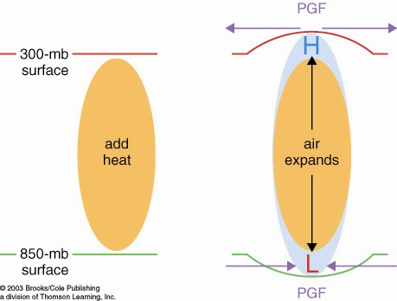
How heated air rises and a warm core vortex develops: the Primitive Equation view. 7 logical steps
1. Warmed column of air gets thicker
2. Air accelerates
due to PGF
2. Air accelerates
due to PGF
1. 200 mb
surface
bulges
upward
0. Heating (maybe latent heating by condensation in a patch
of convection over warm water someplace)

Slide 53
How heated air rises and a warm core vortex develops: the Primitive Equation view. 7 logical steps
3. Mass removal and 4. surface pressure drop
3. Mass removed
from column
3. Mass removed
from column
4. less mass of air in column
= lower surface pressure
L

Slide 54
How heated air rises and a warm core vortex develops: the Primitive Equation view. 7 logical steps
5. Low level inflow accelerates, 6. heated air rises
6. warm
air
rises!
5. Air accelerates
due to PGF
5. Air accelerates
due to PGF

Slide 55
How heated air rises and a warm core vortex develops: the Primitive Equation view. 7 logical steps
ANTI
CYCLONIC
Warm
Core
Vortex
CYCLONIC
FLOW
7. Coriolis turns flow to right

Slide 56
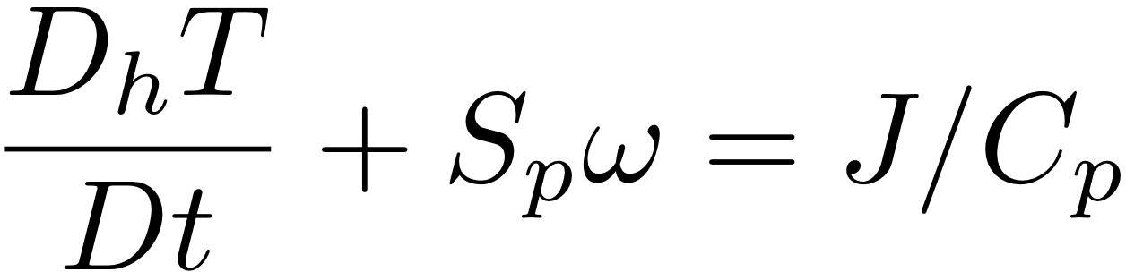
HW: use The Primitive Equations to compute how a local heating J drives flow in an initially motionless atmosphere
J causes T to increase
net change of T =
amount of heat added/Cp
2. Warmer T causes increased thickness of the heated column
3. High Φ over hot column pushes wind outward
4. Surface pressure drops (remember, omega = Dp/Dt; Holton eq. 3.44)
Notes:
Homework 5, MSC 405. Due Thursday, April 13
This problem set walks through the heated-air-rising process above, for a 100 km patch of latent heating in an initially motionless atmosphere.
ALL ANSWERS MUST HAVE UNITS, BUT NUMBERS CAN BE SIMPLE ROUGH ESTIMATES.
Suppose the heating J corresponds to the latent heat released during 1cm of rain over a 100km x 100km area. Let’s figure out how much ΔT that causes.
What is the volume of water condensed (m³)?
What is the mass of water condensed (kg)?
How much latent heat is released (Joules)? (L = 2.5 x 10⁶ J per kg of water).
How many kg of air are in a 1 square meter column of atmosphere, if surface pressure p is 1000mb? M=p/g
How many kg of air are therefore in a 100km x 100km column?
If Cp = 1000 J/(kg K), by how many K can the heat from c. warm the air mass from e.?

Slide 57
HW: use The Primitive Equations to compute how a local heating J drives flow in an initially motionless atmosphere
5. Low Φ under hot column pulls wind inward
6. Hot air rises (finally!)
ω =~ ρgw
7. Coriolis force turns inflowing and outflowing air to make round-and-round flow
Notes:
Homework 5, MSC 405. Due Thursday, April 12
This problem set walks through the sequential process above, for a 100 km patch of latent heating in an initially motionless atmosphere.
ALL ANSWERS MUST HAVE UNITS, BUT NUMBERS SHOULD BE ROUGH: 1-2 SIGNIFICANT DIGITS.
Suppose the heating J corresponds to the latent heat released during 1cm of rain over a 100km x 100km area. Let’s figure out how much ΔT that causes.
What is the volume of water condensed (m³)? (1 point)
What is the mass of water condensed (kg)? (1 point)
How much latent heat is released (Joules)? (1pt) (L = 2.5 x 10⁶ J per kg of water).
How many kg of air are in a 1 square meter column of atmosphere, if surface pressure p is 1000mb? M=p/g (1)
How many kg of air are therefore in a 100km x 100km column? (1)
If Cp = 1000 J/(kg K), by how many K can the heat from c. warm the air mass from e.? (1)

Slide 58

How cooled air sinks and a cool core vortex develops:
the Primitive Equation view. 7 logical steps
1. Cooled column of air gets thinner
2. Air accelerates
due to PGF
2. Air accelerates
due to PGF
200 mb
surface
IR cooling
cold
air
1. 200 mb
surface
bulges
downward

Slide 59
How cooled air sinks and a cool core vortex develops:
the Primitive Equation view. 7 logical steps
3. Mass drawn in
to column
3. Mass drawn in
to column
L
4. more mass of air in column
= higher surface pressure
H

Slide 60
How cooled air sinks and a cool core vortex develops:
the Primitive Equation view. 7 logical steps
L
6. Cold air sinks
5. Air accelerates
due to PGF
5. Air accelerates
due to PGF
H

Slide 61
How cooled air sinks and a cool core vortex develops:
7. Coriolis force turns the winds
L
CYCLONIC
FLOW
Cool
core
Vortex
ANTI
H
CYCLONIC

Slide 62
The geostrophically balanced polar vortex:
The Coriolis force on the westerly jet stream
prevents cold pool of Arctic air from sinking down
and covering the whole Northern Hemisphere
L
Cor.
PGF
PGF
Cor
Heavy cold air
would like to sink
if it could
H

Slide 63
Polar and stratospheric "Reservoirs" of ζ_{a} or PV
Potential vorticity: PV = -g ζ_{a} (∂θ/∂p)
The polar latitudes, where f is large, are a "reservoir" of high PV even when there is no wind!
The stratosphere where (∂θ/∂p) is large is a "reservoir" of PV even when there is no wind!
When tentacles or pieces of the polar & stratospheric PIZZA or OCTOPUS of PV stretch or break off into the midlatitudes, they become our upper-tropospheric synoptic cyclones.

Slide 65
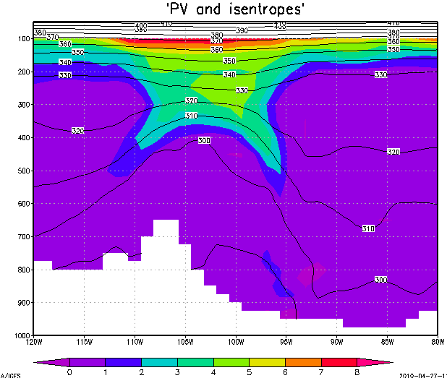
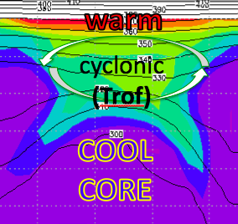
Unsheared advection of T, u, v, vort, PV:
no breaking of balance
warm
cyclonic
(Trof)
COOL
CORE

Slide 66
Sheared advection breaks thermal wind balance
Coriolis force
COOL
CORE
Z Trof

Slide 67
Sheared advection breaks thermal wind balance
imbalanced force = acceleration
COOL
CORE
Z Trof
L

Slide 68
Sheared advection breaks thermal wind balance
imbalanced force = acceleration
COOL
CORE
Z Trof
L

Slide 69
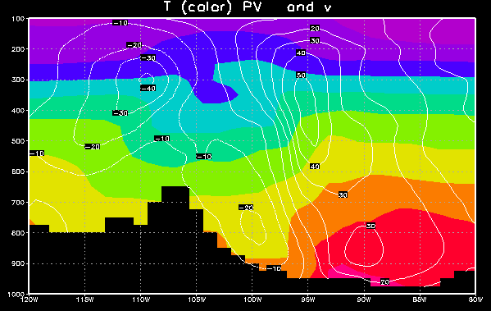
But there is some T advection too
cool air flowing south
warm air flowing north
L

Slide 70
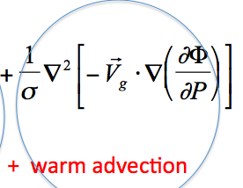
But there is some T advection too
Upward motion ~
cool air flowing south
warm air flowing north
L

Slide 71
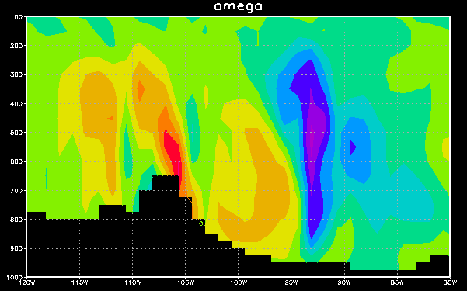
East-west section: omega

